Slide 1
Anaconda Overview
The Journey to Open Data Science Begins with Anaconda
Name
Title
Date

Slide 2
Agenda
Intro to Open Data Science
Anaconda Overview
Anaconda Roadmap

Slide 3
Open Data Science
Introduction to

Slide 4
Data Science is…
An interdisciplinary field about processes and systems to extract knowledge or insights from data in various forms.

Slide 5
Open Data Science is…
an inclusive movement that makes
open source tools of data science
–data, analytics, & computation–
easily work together
as a connected ecosystem

Slide 6
Open Data Science means…
Availability | Innovation | Interoperability | Transparency
For everyone in the data science team
OPEN DATA SCIENCE IS THE
FOUNDATION TO MODERNIZATION
Notes:
Availability
Many tools and approaches
Tools and approaches are interconnected into ecosystem
Future proofing enterprise with OS guarantee – source code availability
Innovation
Constant innovation from best & brightest minds at universities and industry
Delivers agility and the velocity of change increases time-to-value
Many options: Python, R, Java, Hadoop, Scala, Julia and others
Encourages experimentation and quick-to-fail approaches including prototyping that spreads ideas and delivers cutting edge insights to unlock value of data
Interoperability
Leverage new evolving technology
Redeploy legacy technology into modern architectures and apps
Transparency
Code is available for all to see
Easily build on the shoulders of giants who came before resulting in new ideas, research, and innovation

Slide 7
Open Data Science Vibrant and Growing Community
Python Community 30M+
Packages in Anaconda
720+
ANACONDA Downloads
3M+
R Community
16M+
Spark Python Usage
50%+
Notes:
For the Python community, we used the number of pip/virtualenv downloads (http://pypi-ranking.info/module/virtualenv). Total downloads is appr. 45 million (from 2012 to 2016, 46 million if we count the previous years). We used 2/3 as factor to dedupe (same factor we use in the Anaconda downloads)
For the R community, we used the download information from the RStudio CRAN mirror. That is how KDNuggets and others report packages downloads. There is no information for other servers (http://www.computerworld.com/article/2920117/business-intelligence/most-downloaded-r-packages-last-month.html, http://www.kdnuggets.com/2015/06/top-20-r-packages.html). We took the logs from the mirrored RStudio CRAN and computed the downloads from a set of popular packages, e.g. ggplot2, for 2012-2015. I got 2.4 million. We used the same dedupe factor (2/3) and approximated that the total other mirrors are a combined total of 10X.

Slide 8

Machine Learning / Statistics
Data Science is not just Machine Learning…
Business Intelligence
Scientific Computing / HPC
Web
Distributed Systems
Notes:
Python & R
Democratize innovation through broad access to Open Data Science tools
thousands of powerful analytic packages

Slide 9
Machine Learning / Statistics
Data Science is Interdisciplinary…
Classification, deep learning, Regression, PCA
Business Intelligence
Scientific Computing / HPC
Data warehouse, querying, reporting
GPUs, multi-cores
Web
Distributed Systems
Web crawling, scraping, 3rd party data & API providers, predictive services & APIs
Hadoop, Spark
Notes:
Python & R
Democratize innovation through broad access to Open Data Science tools
thousands of powerful analytic packages

Slide 10





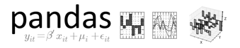
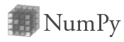








Machine Learning / Statistics
Open Source Communities Creates Powerful Technology for Data Science
Blaze
xlwings
Numba
Business Intelligence
Scientific Computing / HPC
dask
Web
Distributed Systems
Airflow
Notes:
Python & R
Democratize innovation through broad access to Open Data Science tools
thousands of powerful analytic packages

Slide 11

Machine Learning / Statistics
Python is the common language
Blaze
xlwings
Numba
Business Intelligence
Scientific Computing / HPC
dask
Web
Distributed Systems
Airflow
Notes:
Python & R
Democratize innovation through broad access to Open Data Science tools
thousands of powerful analytic packages

Slide 12

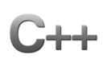


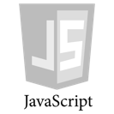

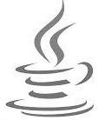

Machine Learning / Statistics
Python’s Not the Only One…
SQL
Business Intelligence
Scientific Computing / HPC
Web
Distributed Systems
Notes:
Python & R
Democratize innovation through broad access to Open Data Science tools
thousands of powerful analytic packages

Slide 13
Machine Learning / Statistics
But it’s also a Great Glue Language
SQL
Business Intelligence
Scientific Computing / HPC
Web
Distributed Systems
Notes:
Python & R
Democratize innovation through broad access to Open Data Science tools
thousands of powerful analytic packages

Slide 14



Machine Learning / Statistics
Anaconda is the Open Data Science Platform Bringing Technology Together…
Blaze
xlwings
Numba
Business Intelligence
Scientific Computing / HPC
dask
Web
Distributed Systems
Airflow
Notes:
Python & R
Democratize innovation through broad access to Open Data Science tools
thousands of powerful analytic packages

Slide 15

Introduction to

Slide 16

…is the leading Open Data Science platform
powered by Python the fastest growing data science language
Accelerate Time-to-Value
Connect Data, Analytics & Compute
Empower Data Science Teams

Slide 17
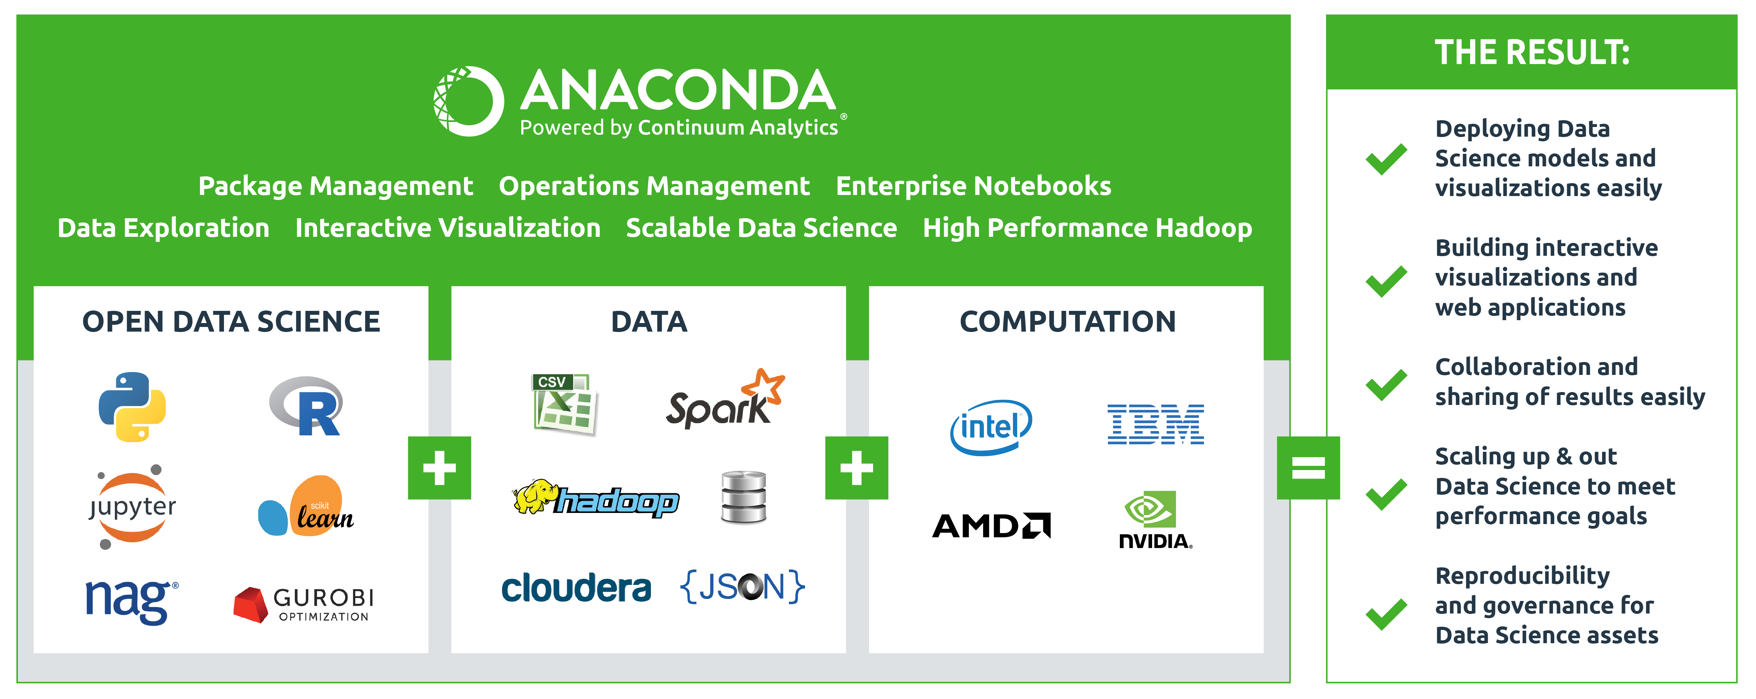
Open Data Science Platform
ACCELERATE. CONNECT. EMPOWER

Slide 18



ACCELERATE
CONNECT
EMPOWER
Time-to-Value
Data, Analytics & Compute
Data Science Teams
INNOVATE faster through managed agile experimentation
MOVE from analysis to deployment immediately
DELIVER powerful results backed by high performance open data science platform
LEVERAGE innovative open source analytics to extract value from data
MAXIMIZE your computational power to easily analyze all data
CONNECT and integrate all your data sources for predictive models
ITERATE quickly to create powerful analysis and predictive models
COLLABORATE and share with your data science team
PUBLISH interactive results to the business

Slide 19
Anaconda Gives Superpowers To People Who Change The World

Slide 20



ANALYTICS ABILITIES
DEVELOPER ABILITIES
DEVOPS ABILITIES
Discover patterns in your data
Create modern advanced analytic applications
Reduce friction moving analytics into production
EXPLORE data interactively with high impact visualizations
INNOVATE high value solutions using open source analytics
COLLABORATE and share results easily
INTEGRATE with existing and evolving data and environments
BUILD interactive visualizations and applications
SCALE up and out applications to meet performance goals
DEPLOY predictive models and visualizations easily
MANAGE packages, dependencies and environments
GOVERN security and authorizations

Slide 21


Arms citizen data scientists with power to evaluate tax policies
“
CHALLENGE
Working with such a large dataset, the team at TaxBrain needed technology that would allow their mathematically intensive economic simulation models to be fast, efficient and easy to access for open source contributors.
SOLUTION
TaxBrain is able to hit performance goals and maintain stronger relationships with open source contributors through the use of the Anaconda platform for development, hosting, package management and high performance speed ups.
ANACONDA SPEEDS UP OPEN SOURCE POLICY MODELING 100X
We’ve enabled citizens to have a much more direct impact on policy outcomes; the numbers that policy makers are seeing when considering different policies are now generated by tools that can be improved by anyone with the skills and passion to do so.
Matthew Jensen
”

Slide 22
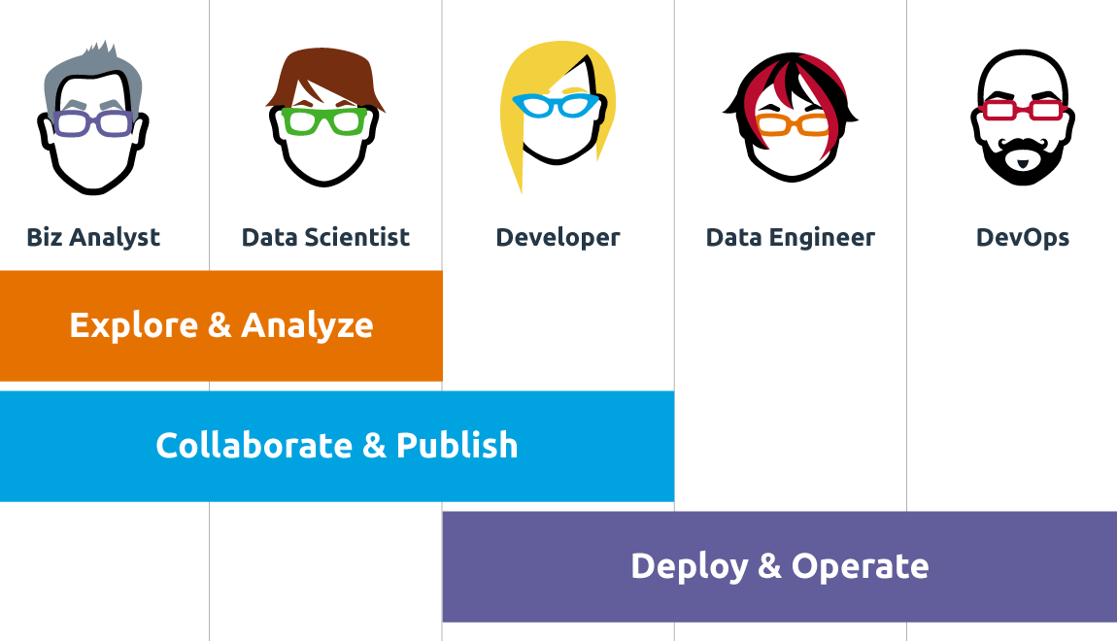
Empowering the Data Science Team
Notes:
Michele

Slide 23




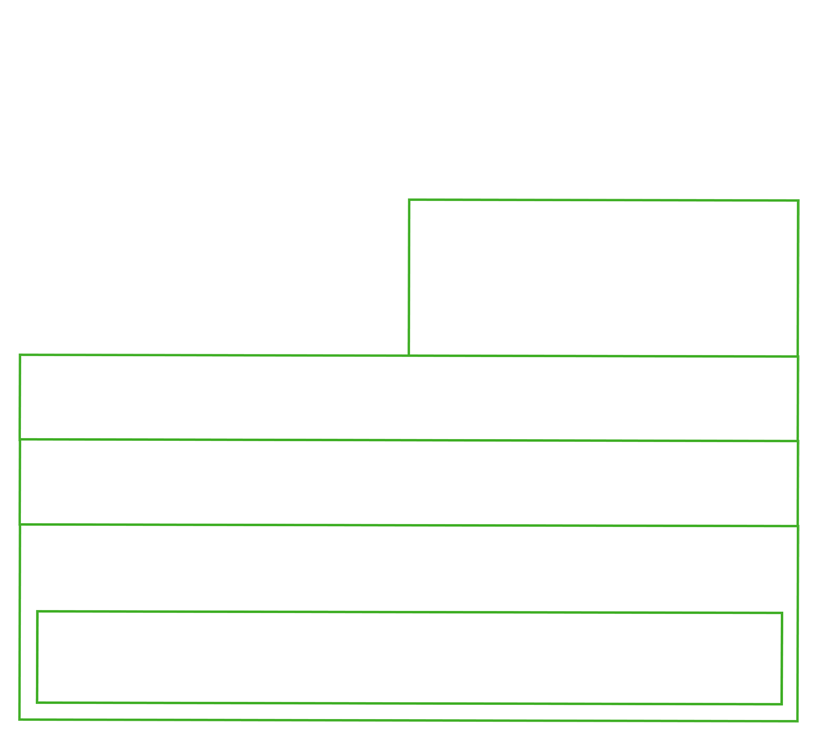


ANACONDA platform
ANACONDA FUSION
Excel Data Science
Data Science Collaboration
ANACONDA ENTERPRISE NOTEBOOKS
ANACONDA MOSAIC
Heterogeneous Data Exploration
ANACONDA SCALE
Distributed Computing
ANACONDA ACCELERATE
High Performance Computing
ANACONDA REPOSITORY
Open Data Science Hub
ANACONDA DISTRIBUTION
Open Data Science Core

Slide 24






Modern Data Science Teams Love ANACONDA
Biz Analyst
Data Scientist
Developer
Data Engineer
DevOps
Spreadsheets
Visualization
Notebooks
Analytic Development Environment
Hadoop / Spark
Programming Languages
Analytic Libraries
IDE
Notebooks
Visualization
Programming Languages
Analytic Libraries
IDE
Notebooks
Visualization
Database / Data Warehouse
ETL
Database / Data Warehouse
Middleware
Programming Languages
Notes:
They choose Anaconda because it’s the
RIGHT TECHNOLOGY FOR THEIR PROBLEM

Slide 25
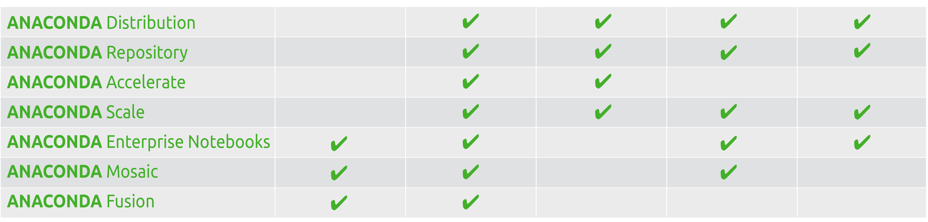
Anaconda Empowers the Data Science Team
Biz Analyst
Data Scientist
Developer
Data Engineer
DevOps

Slide 26


ANACONDA Accelerates Adoption of Open Data Science for Enterprises
PYTHON & R OPEN SOURCE ANALYTICS
Easy to install
Agile data exploration
Powerful data analysis
Simple to collaborate
Accessible to everyone
NumPy
SciPy
Pandas
Scikit-learn
Jupyter/IPython
Numba
Matplotlib
Spyder
Numexpr
Cython
Theano
Scikit-image
NLTK
NetworkX
IRKernel
dplyr
shiny
ggplot2
tidyr
caret
PySpark
& 720+ packages
Notes:
Open source now & forever – BSD license
Enterprise ready – easy to install with tested and validated packages

Slide 27



Introducing Anaconda The Leading Open Data Science Platform Powered by Python
Data Science
Team
Enterprise Ready Platform
Simplify administration
Use modern data science
Collaborate with the entire team
Leverage modern architectures
Integrate data sources
Accelerate performance
HIGH PERFORMANCE
Business
Analyst
APPLICATIONS
DATA SCIENCE
LANGUAGES
ANALYTICS
OPERATIONS
Data
Scientist
Advanced Analytics
Data Exploration
Analytics Development
Developer
SOFTWARE DEVELOPMENT
Data
Engineer
DATA
HARDWARE
DevOps
Cloud
On-premises

Slide 28
OPERATIONS
Governance
Provenance
Security

Slide 29
Anaconda Powers
OPEN DATA SCIENCE
DATA SCIENCE COLLABORATION
SELF-SERVICE DATA SCIENCE
DATA SCIENCE DEPLOYMENT
Anaconda Distribution
Anaconda Scale
Anaconda Enterprise Notebooks
Anaconda Fusion
Anaconda Mosaic
Anaconda Repository
Anaconda Accelerate

Slide 30
Anaconda Today
OPEN DATA SCIENCE
DATA SCIENCE COLLABORATION
SELF-SERVICE DATA SCIENCE
DATA SCIENCE DEPLOYMENT
Anaconda Distribution
High performance Python & R
720+ data science packages
Cross-platform package, dependency & environments
Community driven package repository collaboration
Anaconda Scale
Hadoop & Spark integration
Scalable distributed processing framework
Integration with resource management & data stores
Self-service cluster launching
Distributed package, dependency & environments
Anaconda Navigator
Desktop Installer
Anaconda Adam
Server & Cluster Installer
Anaconda Enterprise Notebooks
Collaborative project based workflows for Python & R
Enterprise authentication & permissioning
Notebook sharing, versioning, search, differencing
Anaconda Mosaic
Data transformations
Interactive data exploration
Data lineage
Heterogeneous data
Anaconda Repository
Storage & sharing of packages, environments, notebooks
On-premise governance
Enterprise authentication
Anaconda Accelerate
Python compilation for multi-core & GPUs
Code, data, in-notebook profilers
Pre-optimized numerical libraries
Notes:
Resource management – beginning with YARN, slurm, torque, SGE

Slide 31
Enterprise Platform for Open Data Science
PYTHON
Capitalize on Intel MKL optimized Python for faster numerical processing
Harness Python advanced analytics innovation for Data Science
Use multiple Python versions
Reduce risk with open source certified packages and indemnification
Activate power of full Python ecosystem
R
Use Microsoft R Open with MKL optimization for faster numerical processing
Leverage R Essentials for predictive models
SPARK | SCALA
Leverage Spark directly or through PySpark and SparkR
FORTRAN | C | C++
Integrate legacy analytics into modern applications
DATA SCIENCE
LANGUAGES
Python
R
Spark | Scala
JavaScript
Java
Fortran
C/C++

Slide 32
Enterprise Operations for Open Data Science
DISTRIBUTION
Runs on Windows, Mac, Linux
Allows commercial redistribution
REPOSITORY
Establish a secure and robust repository of 700+ certified Python, R, Scala data science packages on-premises or in cloud
Expose knowledge buried in analysis spread across disparate teams and files servers with centralized repository
PACKAGES, DEPENDENCIES, ENVIROMENTS
Adopt a cross-platform, multi-language open source package and dependency manager
Reproduce environments easily by encapsulating and isolating environments
SECURITY
Authenticate with SSO using AD/LDAP or Kerberos
GOVERNANCE
Manage user and team privileges
PROVENANCE
Track data lineage, versioning and computational results
PRODUCTION DEPLOYMENT
Reproduce Data Science team models with complex dependencies in production easily
OPERATIONS
Governance
Provenance
Security

Slide 33
Enterprise Infrastructure for Open Data Science
WORKSTATION
Take advantage of multi-cores to create powerful Data Science solutions on your desktop
SERVER
Share notebooks, packages and environments
Control and monitor package usage on-premises that can include white or black lists
Iterate and collaborate via secure Enterprise Notebooks with your Data Science team
Publish presentations and visualizations throughout your enterprise
Scale up your solutions to use more data and computational processing power
CLUSTER
Provision and execute Python and R packages onto cluster easily
Leverage Spark processing with PySpark and SparkR
Take advantage of Python and R advanced analytics on Spark
Manage packages and multiple environments dynamically
Plug into YARN, HDFS, Storm, Streaming, ElasticSearch
Get 10-100X performance increase on Hadoop
HARDWARE
Workstation
Server
Cluster

Slide 34
Enterprise Data Integration for Open Data Science
ANY DATA
Process data out-of-core to scale up
Distribute querying and computation
Write queries through common interface for heterogeneous back ends
FLAT FILES
Ingest and output any type of flat files including CSV, XLS
SQL DB and SQL NoSQL
Use high speed connectors to speed up data ingestion and output
HADOOP
Read and write directly to Hadoop stores
STREAMING
Leverage streaming data with Storm and Kafka
DATA
Flat Files (CSV, XLS…))
SQL DB
NoSQL
Hadoop
Streaming

Slide 35
Enterprise Data Exploration for Open Data Science
MOSAIC
Explore data in-place through an intuitive web UI backed by powerful computation engine
Unify querying for disparate back ends through common interface for heterogeneous back ends - SQL, NoSQL, JSON, Streaming
Interact with data in tables, plots, and charts
Write transformations and queries once and apply to multiple back ends
Track, reuse and version data, expressions and computations
Distribute querying and computation processing to back end
DATA CONNECTORS
Use high speed connectors to accelerate data ingestion and output
DATA PREP
Extract, load, and transform data easily
ANALYTICS
Data Exploration
Querying
Data Prep
Data Connectors

Slide 36
Enterprise Software Development for Open Data Science
PACKAGES, DEPENDENCIES, ENVIRONMENTS
Build, test and distribute Python, R, Scala, Fortran, C/C++, JS packages and dependencies
Encapsulate and reproduce environments easily
WEB AND DESKTOP APPLICATIONS DEVELOPMENT
Build web and desktop applications that can easily integrate Data Science predictive models
IDE
Pick from a variety of IDEs to write software packages
SOFTWARE DEVELOPMENT
Package, Dependency, Environment Management
Web & Desktop App Dev
IDEs

Slide 37
Enterprise Analytics Development for Open Data Science
ENTERPRISE NOTEBOOKS
Use Python, R or Scala to create and execute collaborative notebooks
Compare notebooks and identify differences
Search notebooks for keywords and packages
Use version control and collaborative locking on notebooks
Publish notebooks to the cloud or on-premises repository
Make Data Science teams more efficient through agile notebook collaboration
Create powerful branded interactive narratives to share model results
INTERACTIVE VISUALIZATION
Build interactive browser based visualizations and apps with Python, R, Scala and JavaScript
Interact with statistical plots, charts and analytic applications
Experience interactive Big Data and real-time geospatial and time series visualizations
VISUAL PROGRAMMING
Create predictive models with drag and drop visual programming
ANACONDA CLOUD
Publish and share packages, notebooks & environments
ANALYTICS
Analytics
Development
Visual
Programming
Notebooks

Slide 38
Enterprise Advanced Analytics for Open Data Science
ADVANCED ANALYTICS
Choose from 700+ certified Python, R and Spark/Scala packages in repository for statistics, data mining, machine learning, deep learning, simulation & optimization, text & NLP, geospatial, graph & network analysis, image/video/audio analysis
Build numerical, statistical, predictive models with Python, R or Scala
ADVANCED ANALYTICS
Choose your favorite interface for model building – command line, IDE or visual programming
Share and learn from Anaconda community via Anaconda Cloud
ANALYTICS
Advanced Analytics
Data Mining
Stats
Deep Learning
Machine Learning
Simulation & Optimization
Geospatial
Text & NLP
Graph & Network
Image Analysis

Slide 39
Enterprise Applications for Open Data Science
ENTERPRISE NOTEBOOKS
Share executable notebooks with data narratives and interactive visualizations
INTERACTIVE PRESENTATIONS
Publish powerful branded interactive narratives to share model discoveries with executives
Create PDFs for easy dissemination of model results
ADVANCED SPREADSHEETS
Use the familiar MS Excel with powerful Python analytics
See interactive visualizations in MS Excel
INTERACTIVE APPS & REPORTS
Use intelligent interactive visualizations and analytic applications throughout enterprise
View, interact and transform 1B+ rows in real time in the browser
Experience interactive Big Data and real time geospatial and time series visualizations
APIs
Automate embedding of predictive model with a RESTful API generator
APPLICATIONS
Reports
Notebooks
Visual Data Exploration
Advanced Spreadsheets
Solution Templates
APIs

Slide 40
Enterprise Python Optimization for Open Data Science
HIGH PERFORMANCE
DISTRIBUTED COMPUTING
Query and schedule tasks on a cluster
PARALLELISM & MULTI-THREADING
Write parallel machine learning and statistics algorithms easily
GPUs & MULTI-CORES
Take advantage of multi-cores and GPU hardware with compiled Python
Optimized for for 32 and 64-bit x86 CPUs
Use multi-core math libraries
COMPILER
Boost Python performance 2-200X with Python compiler
COMPILED ASSETS
Exploit optimized GPU libraries with easy-to-use Python interface for Intel and NVIDA provided algorithms for: linear algebra, Monte Carlo simulation, sparse matrix operations, fast array functions, FFTs, sorting
Reuse and package legacy code
Improve performance through use of compiled assets (C/C++/Fortran)
Employ highly optimized Python for optimal performance on Intel CPUs
PROFILING
Utilize data, code and in-notebook profilers to identify bottlenecks
HIGH
PERFORMANCE
Distributed
Computing
Parallelism & Multi-threading
Compiled Assets
GPUs & Multi-core
Compiler

Slide 41
Anaconda Powers Teams
EXPLORE & ANALYZE
Explore & prepare data
Build, test, validate data science models with Python & R
Build simulations & optimizations
View data lineage & reuse transformations
Leverage & explore metadata
COLLABORATE & PUBLISH
Create & share data science notebooks with interactive visualizations
Identify reusable data science assets easily
Authorize access to data science projects
Manage & control data science asset versions
DEPLOY & OPERATE
Build & share data science packages & environments
Launch & provision distributed environments

Slide 42




Write Once, Deploy Anywhere
Hadoop
Cloudera, Hortonworks
Apache Hadoop & Spark
NoSQL
MongoDB
Cassandra / DataStax
DW & SQL
Any SQL DB
Any SQL DW, Impala
Explore & Analyze
Collaborate & Publish
Deploy & Operate
Files
Microsoft Excel
Trifacta, Import.io
OPEN DATA SCIENCE
Clusters
Yarn, Mesos, MPI
Power8, LSF, Sungrid Engine
GPUs & High End Workstations
Linux & Windows
NVIDIA, AMD, X86/ARM
Servers
Linux, Windows
OSX

Slide 43

Anaconda Accelerates Adoption of Open Data Science for Enterprises
Explore & Visualize complex data easily
Harness Open Source Python & R Analytics
Write Once, Deploy Anywhere for Scalable High Performance
Collaborate with Your Team anywhere in the World
Data Engineering Simplified for All Data
Integrate Data from Anywhere
Across all Data, Operating Systems, & Hardware Platforms
Notes:
Explore & Visualize complex data easily
Use your experience and curiosity to explore and analyze your data. Choose from a rich set of interactive visualizations to bring your data to life and tell an insightful story. Discover new patterns and anomalies that empower your team to realize impactful value from your data.
Exploit Open Source Python & R Analytics.
Python is the fastest growing language for data science. In addition to the 330+ Python open source packages in Anaconda, you can leverage your favorite R packages. This powerful combination allows you to do everything you want from BI to advanced modeling on complex, Big Data.
Write Once, Deploy Anywhere for High Performance & Scalability
Develop on your desktop and scale up to high performance easily. Anaconda empowers you to easily distribute and parallelize your analytics. Write once and deploy anywhere – Hadoop, Spark, clusters, GPUs, servers – to get the throughput and performance you need to meet your SLAs. Leverage out-of-box parallelized analytics or automatically thread your own analytics.
Collaborate with your team anywhere in the world.
Great collaboration starts with great communication. Anaconda simplifies publishing of reproducible packages and notebooks including the runtime environment making your working context portable. Notebooks make it easy for everyone on the team – data scientists, business analysts, ops - to see or hide the code, documentation, plots and interactive visualizations. Sharing this transparently across the entire team aligns the team, streamlines feedback and expedites deployment.
Data Engineering Simplified for All Data.
Understanding data and transforming it is crucial to getting accurate results from your data science efforts. Data engineering requires a board set of capabilities to ingest the data from any data source and perform transformation from simple data treatments to highly complex, interdependent transformations. As the leading open source modern analytics platform, Anaconda includes the flexibility and power you need to perform all your data engineering.
Integrate data from anywhere
Integrating data from the wide variety of internal and external data sources can be daunting. But not with Python. Over the years, the Python community has developed a large quantity of open source connectors that have been validated to integrate everything from the most commonly used systems to the most obscure. The open design of Python allows Python to easily be wrapped into other languages or to be the wrapper for other languages. This flexibility allows you to leverage legacy code and bring it forward into modern architectures.
Cross Data Platforms – Hadoop & Hive, Spark, NoSQL, DW& SQL, Files & Web Svcs
Cross OS Platforms – Windows, Linux, Mac
Cross HW Platforms – Local, Cloud (VM, public), Workstation/Server

Slide 44
Anaconda Learning Paths
Data Scientist
Intro to Data Science with Anaconda
Intro to Data Science @Scale with Anaconda, Spark & Distributed Processing
Intro to Developing Big Data Applications with Anaconda
Machine Learning & Deep Learning with Anaconda
Machine Learning & Deep Learning @Scale with Anaconda, Spark & Distributed Processing

Slide 45
Anaconda Learning Paths
Intro to Deployment with Anaconda
Intro to Administering Anaconda
Advanced Deployment with Anaconda
DevOps
Biz Analyst
Introduction to Self-Service Data Science with Anaconda
Advanced Self-Service Data Science with Anaconda

Slide 46
Anaconda Learning Paths
Intro to Data Science @ Scale with Anaconda, Spark & Distributed Processing
Intro to Developing Big Data Applications with Anaconda
Machine Learning & Deep Learning @Scale with Anaconda, Spark & Distributed Processing
Developer
Data Engineer
Introduction to Data Engineering with Anaconda
Advanced Data Engineering with Anaconda

Slide 47
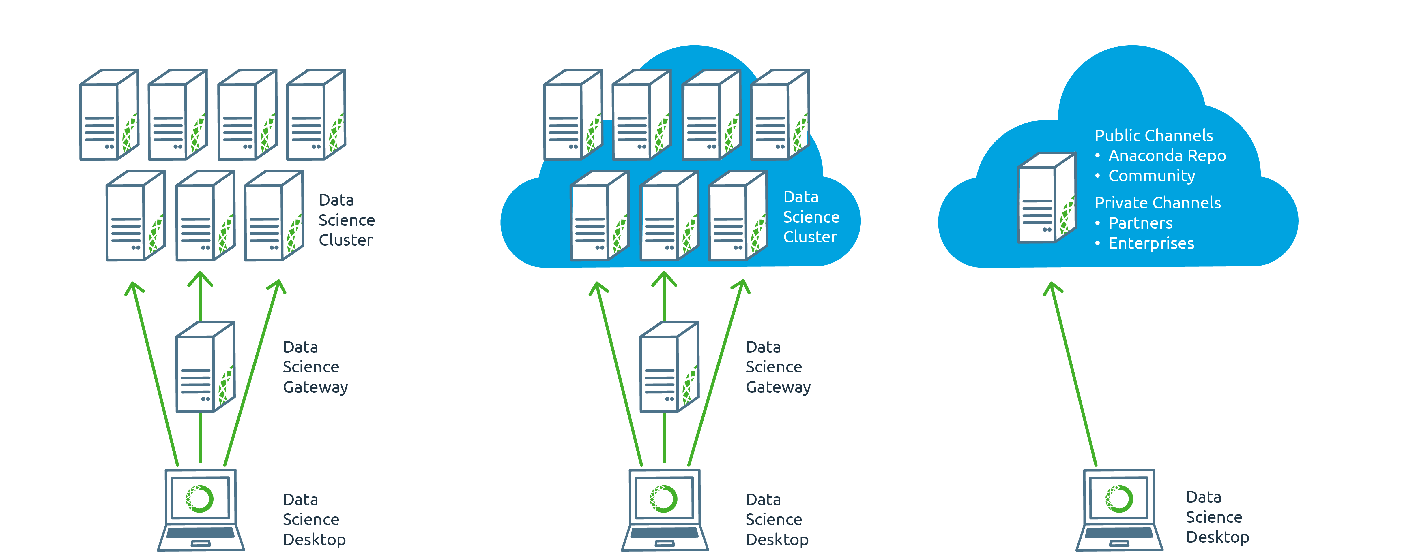
Anaconda Architectures
ON-PREMISE
PRIVATE CLOUD
ANACONDA CLOUD

Slide 48
Anaconda Subscription
Overview of

Slide 49
ANACONDA Subscriptions
ANACONDA FUSION
ANACONDA FUSION
ANACONDA FUSION
ANACONDA ENTERPRISE NOTEBOOKS
ANACONDA MOSAIC
ANACONDA ENTERPRISE NOTEBOOKS
ANACONDA MOSAIC
ANACONDA ENTERPRISE NOTEBOOKS
ANACONDA MOSAIC
ANACONDA SCALE
ANACONDA SCALE
ANACONDA SCALE
ANACONDA ACCELERATE
ANACONDA ACCELERATE
ANACONDA ACCELERATE
ANACONDA REPOSITORY
ANACONDA REPOSITORY
ANACONDA REPOSITORY
ANACONDA DISTRIBUTION
ANACONDA DISTRIBUTION
ANACONDA DISTRIBUTION
ANACONDA
ANACONDA PRO
ANACONDA WORKGROUP
ANACONDA ENTERPRISE

Slide 50
ANACONDA Subscriptions
 | ANACONDA PRO | ANACONDA WORKGROUP | ANACONDA ENTERPRISE
ANACONDA DISTRIBUTION | ✔️ | ✔️ | ✔️
ANACONDA REPOSITORY |  | ✔️ | ✔️
ANACONDA ACCELERATE |  | ✔️ | ✔️
ANACONDA SCALE |  | ✔️ | ✔️
ANACONDA ENTERPRISE NOTEBOOKS |  |  | ✔️
ANACONDA MOSAIC |  |  | ✔️
ANACONDA FUSION |  |  | ✔️

Slide 51
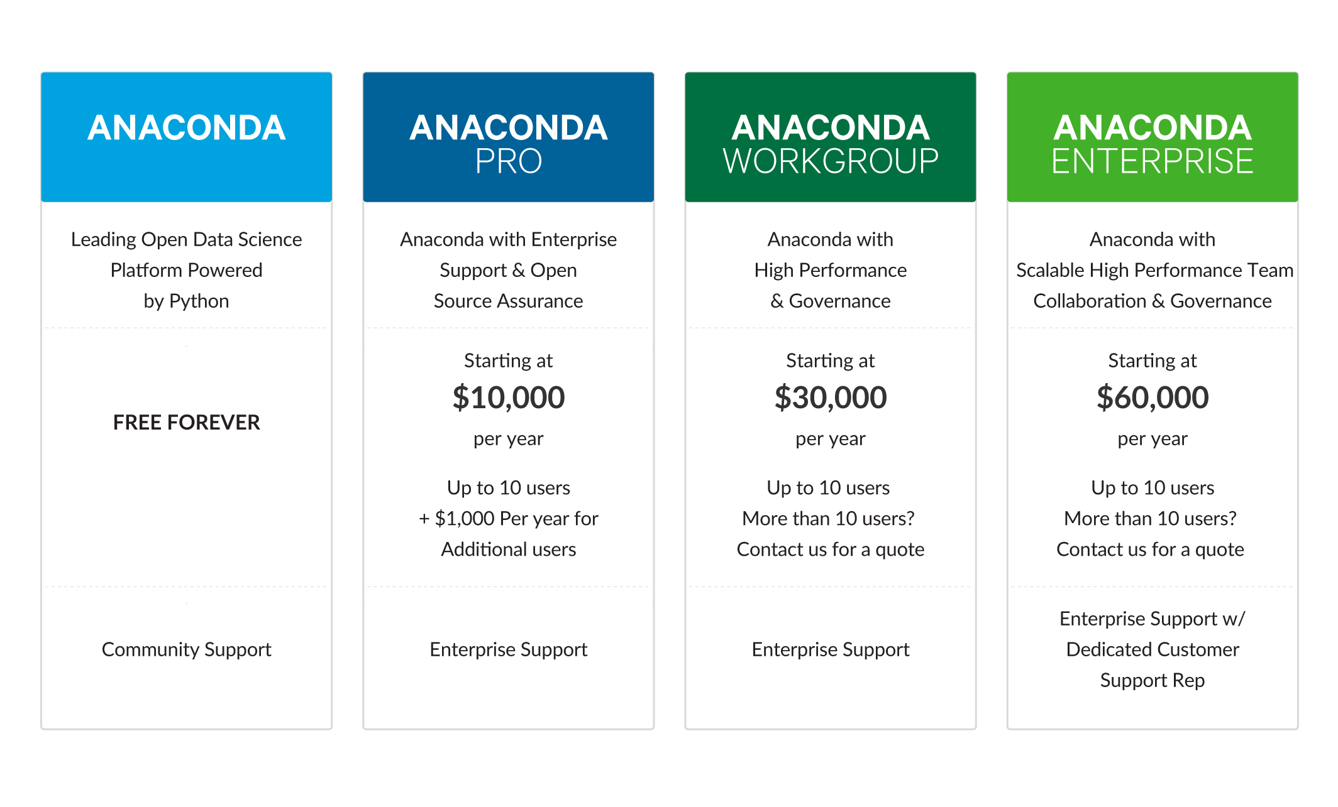
Anaconda Subscriptions

Slide 52
Anaconda Crew
Introduction to

Slide 53





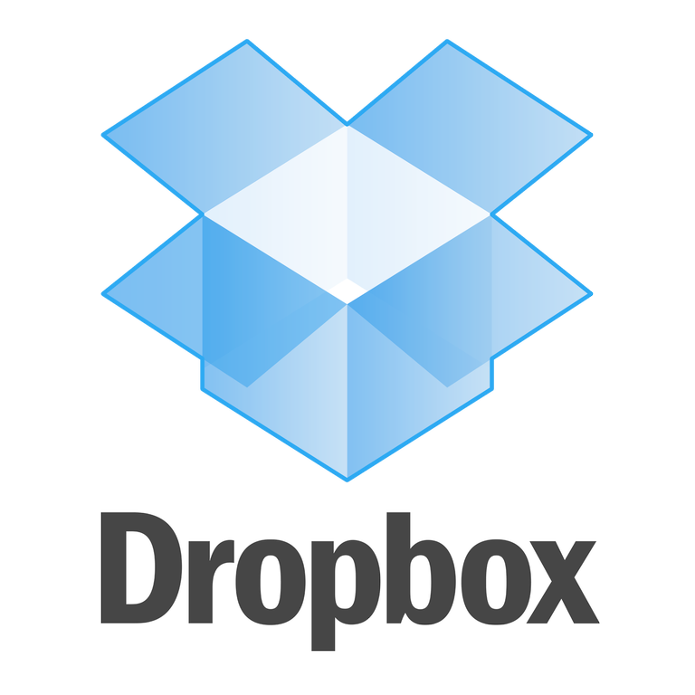

Python Trusted by Industry Leaders
Notes:
Travis

Slide 54
Anaconda
…is Trusted by Industry Leaders
Financial Services
Risk management, Quant modeling, Data exploration and processing, algorithmic trading, compliance reporting
Government
Fraud detection, data crawling, web & cyber data analytics, statistical modeling
Healthcare & Life Sciences
Genomics data processing, cancer research, natural language processing for health data science
High Tech
Customer behavior, recommendations, ad bidding, retargeting, social media analytics
Retail & CPG
Engineering simulation, supply chain modeling, scientific analysis
Oil & Gas
Pipeline monitoring, noise logging, seismic data processing, geophysics

Slide 55
Python is Everywhere
Everyone at JPMorgan now needs to know Python and there are around 5,000 developers using it at Bank of America. There are close to 10 million lines of Python code in Quartz and we got close to 3,000 commits a day. It’s a good scripting language and easily integrated into both the front and back ends, which was one of the reasons we chose it in the first place.
Kirat Singh, Former Global Head of Risk Systems, Bank of America Merrill Lynch

Slide 56
Why are major corporations moving to Open Data Science?
Large Investment Banks
Global CPG Manufacturers
Major Upstream Oil & Gas
How can I create and deploy timely risk models?
How can I possibly identify the root causes of my complex problem and remediate early enough to create revenue assurance?
How can I take advantage of all this new sensor information now?
Notes:
Michele

Slide 57
To Reduce Time, Risk & Lock-in…
Large Investment Bank
Global CPG Manufacturer
Major Upstream Oil & Gas
Problem
Hard to find people to create proprietary risk assessment models
Takes months and years to deploy
Solution
Moved to ODS and leveraged innovation in ODS
Results
Create and deploy risk models in days not years with easier to find and hire data scientists
Problem
Complex model and simulation required with disparate internal and external data
Solution
Moved to ODS to easily integrate multiple data feeds and leverage OS innovation
Results
Created full lifecycle predictive model and simulation for revenue assurance
Problem
Unable to ingest Big Data from sensors to proactively monitor oil well holes
Solution
Moved to ODS and leveraged diversity of ODS analytics to create novel visualizations and predictive models using sensor data
Results
Gained insights into oil hole issues in weeks not years to detect issues earlier and increase profitability
Notes:
Travis
Large Investment Banks
Problem: Each LOB (line of business) had their own data and it took months and years to build risk assessment models plus it was hard to find people that had skills in the proprietary tools they used to build the models.
Solution: Moved to ODS and brought data together into one logical system. They are now able to create models in days and weeks leveraging the innovation in ODS and they can easily find skilled people
Global CPG Manufacturer
Problem: Needed to create complex model and simulations using product development, manufacturing, CRM, and supply chain data to ensure product integrity/mixture on the shelves at the retailer
Solution: Moved to ODS and brought together siloed internal and external (national weather service) data into machine learning model that leveraged ODS innovations to simulate and monitor full life cycle from science through logistics
Major Upstream Oil & Gas
Problem: Unable to ingest and take advantage of data from new sensor innovations for proactively monitoring oil well holes
Solution: Moved to ODS to easily use and visualize sensor information gathered from light scattering that maps to motion in the oil well hole to detect issues earlier (weeks not years) and increase profitability

Slide 58

Anaconda
Partners with Industry Leaders
nag

Slide 59
Continuum Analytics
Overview of

Slide 60
Continuum Analytics
Our Beginning
Travis Oliphant & Peter Wang co-founded in 2012
Team includes OSS authors: NumPy, SciPy, PyTables, Pandas, Jupyter
Vision foundational tools for next generation data scientists
Our History
Our Team
July 2012
June 2013
May 2014
September 2014 December 2015
July 2016
V1 | Anaconda
10K / mon Anaconda downloads
V2 | Anaconda
100K / mon Anaconda downloads
225K / mon Anaconda downloads
V4 | Anaconda & 550K / mon downloads
Notes:
Product / Services
100 $10K+ customers
30 – strategic customers - $50K+/yr
Fortune 500
Global 1000

Slide 61
Continuum Analytics
Global Community 3M+
OSS Contributors
50+
Enterprise Customers
30+
Industries
Financial Services
Government
Health & Life Sciences
Retail & CPG
Oil & Gas
High Tech
Investors
General Catalyst
BuildGroup
In-Q-Tel
Global Presence
Americas
EMEA
Notes:
Product / Services
100 $10K+ customers
30 – strategic customers - $50K+/yr
Fortune 500
Global 1000

Slide 62
2012
2013
2014
2015
July
V1 Anaconda
Sept
NumFOCUS receives 501(c)(3) status
Oct
1st PyData conference
Jan
DARPA XDATA project (Blaze, Numba, Bokeh)
Mar
Wakari.io launch
June
10k/month Anaconda downloads
May
V2 Anaconda, 1st Anaconda Server sale
June
100K/mon Conda downloads
Oct
~50% team growth
2M/mon Conda downloads
Feb
InQTel funding
Mar
General Catalyst & BuildGroup funding
June
4.8M/mon Conda downloads
July
5M/mon Conda downloads
200k/mon Anaconda downloads

Slide 63
Our Mission
We help people discover, analyze and collaborate by connecting their curiosity and experience with any data

Slide 64

It All Starts Here

Slide 65
PYTHON & R

Slide 66


Open Data Science Ecosystem
Visualization
Encapsulation
Exploration
Simulation
& Optimization
UI Toolkits
IDEs / ADEs
Analytic Packages
API & Cloud
Connectors

Slide 67
Foundational Python Packages
Visualization
Encapsulation
Exploration
OpenCV
PySAL
NLTK
UI Toolkits
Simulation & Optimization
PyTables
statsmodels
Networkx
scikit-image
scikit-learn
Numba
IDEs / ADEs
Analytic Packages
SciPy
Pandas
Matplotlib
API & Cloud Connectors
NumPy

Slide 68
Foundational R Packages
Visualization
Encapsulation
Exploration
glmnet
jsonlite
zoo
UI Toolkits
Simulation & Optimization
data.table
shiny
rmarkdown
caret
randomForest
quantmod
IDEs / ADEs
Analytic Packages
reshape2
dplyr
tidyr
API & Cloud Connectors
IRKernel
ggplot2
rplyr

Slide 69
Continuum Analytics
We empower data science teams to make the world a better place
We Empower Data Science Teams to Make the World Better
221 W. 6th Street
Suite #1550
Austin, TX 78701
+1 512.222.5400

